Slide 1
Standing Waves Simulations
For 10 GHz Clock
On Virtuoso Cadence

Slide 2
Objective
The aim of these simulations is to observe the effect of the standing waves on the voltage amplitudes across the transmission line, while changing line length and loading conditions.
Loading conditions:
Short
Open
Inductive
Connected at far-end
Connected at near-end
Connected at mid-point
Capacitive
Connected at far-end
Connected at near-end
Connected at mid-point

Slide 3

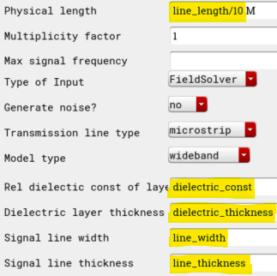
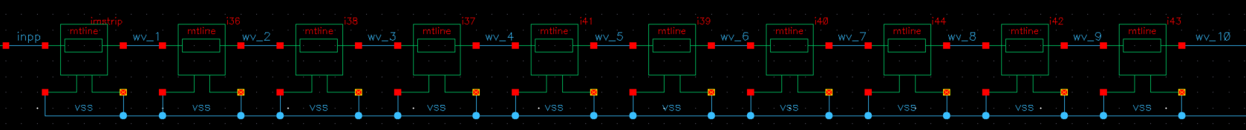
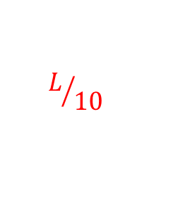
Channel used for simulations
Channel model used is represented by a 10-segment mtline of total length = L (It is modelled this way in order to observe the voltage at different locations on the transmission line)
$$L/{10}$$
Channel Length = L

Slide 4
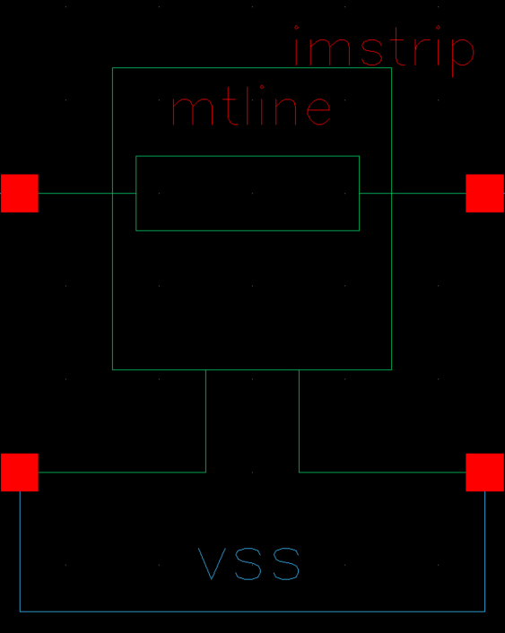
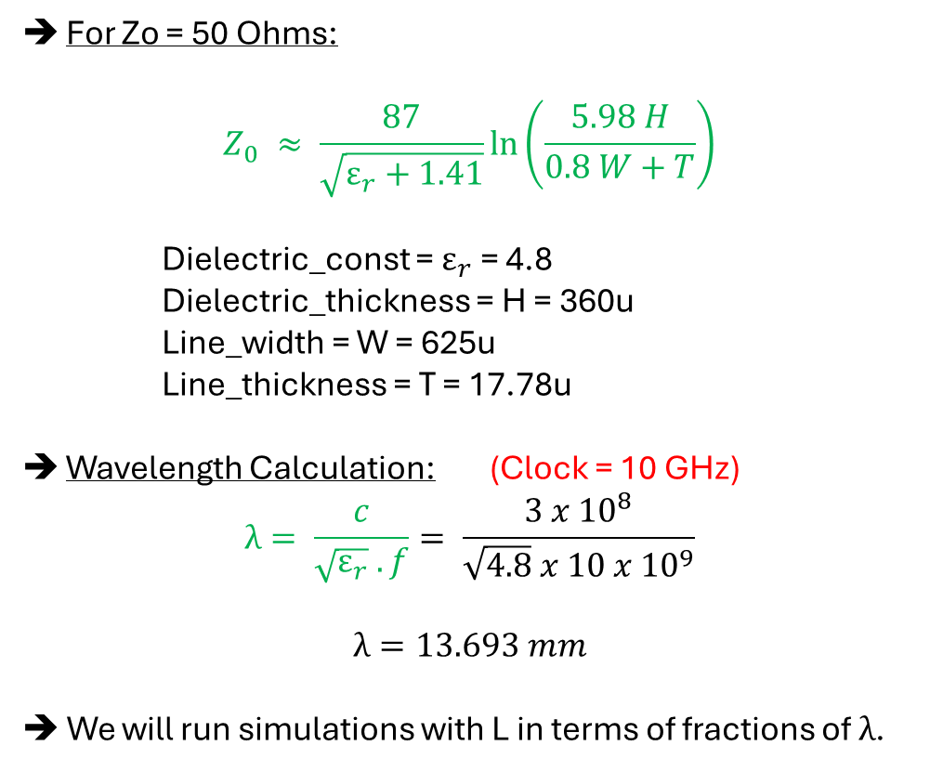
MTLINE Settings
Mtline:
For Zo = 50 Ohms:
$$Z_{0} ≈ \frac{87}{\sqrt{ε_{r}+1.41}}\ln\left(\frac{5.98 H}{0.8 W+T}\right)$$
Dielectric_const = $ε_{r}$= 4.8
Dielectric_thickness = H = 360u
Line_width = W = 625u
Line_thickness = T = 17.78u
Wavelength Calculation: (Clock = 10 GHz)
$$λ= \frac{c}{\sqrt{ε_{r}} . f}= \frac{3 x {10}^{8}}{\sqrt{4.8} x 10 x {10}^{9}}$$
$$λ=13.693 mm$$
➔ We will run simulations with L in terms of fractions of $λ$.

Slide 5
1) Short Load
(for λ/4 Resonator)

Slide 6
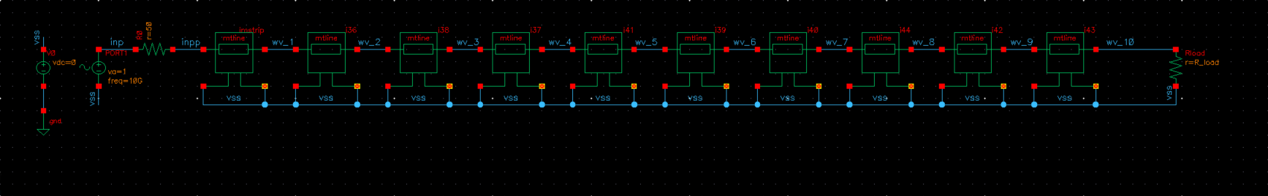

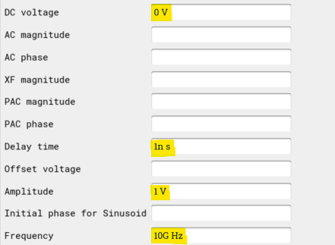
TB Schematics
Sine Source (10 GHz)
RL = 0

Slide 7
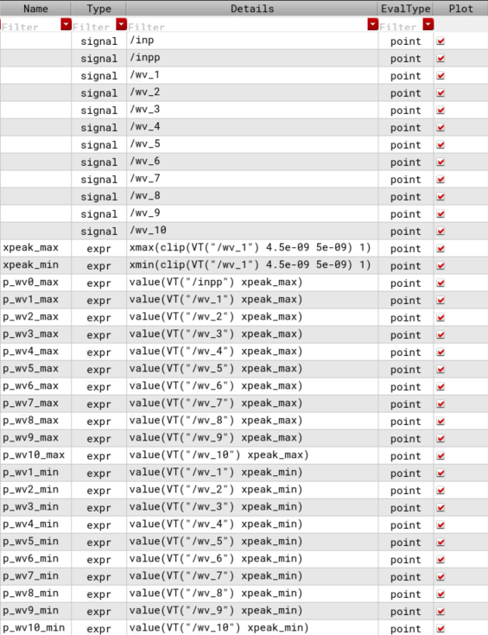
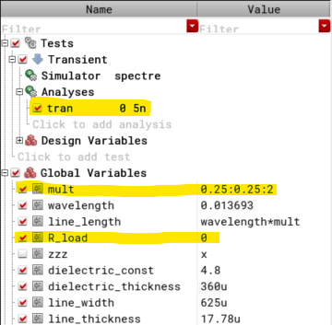
TB Maestro Setup

Slide 8
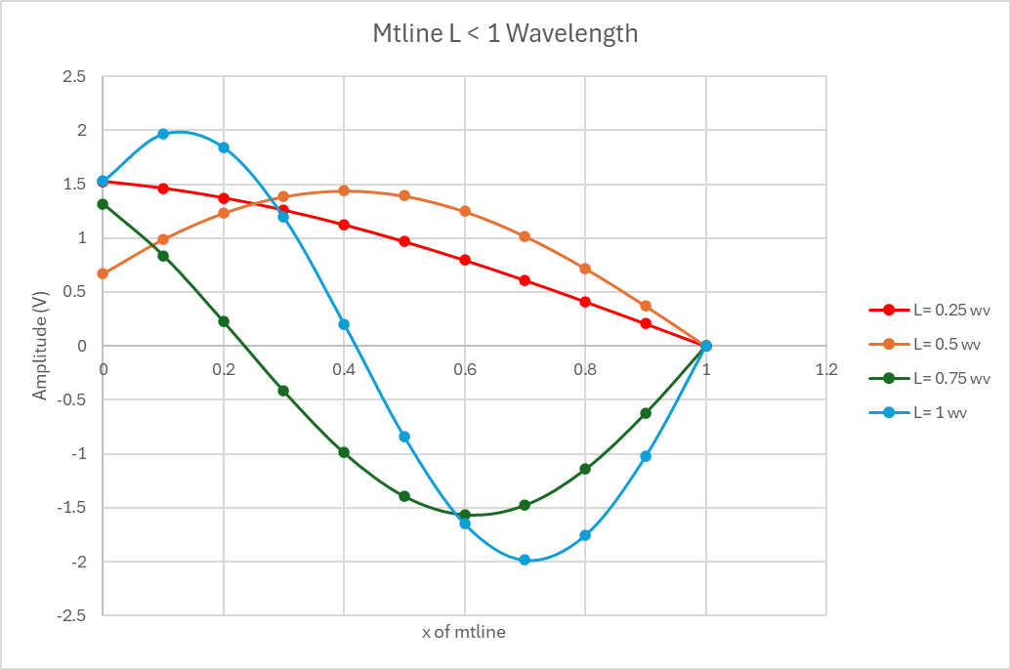
Results
Voltage Amplitudes Vs Distance for different L s

Slide 9
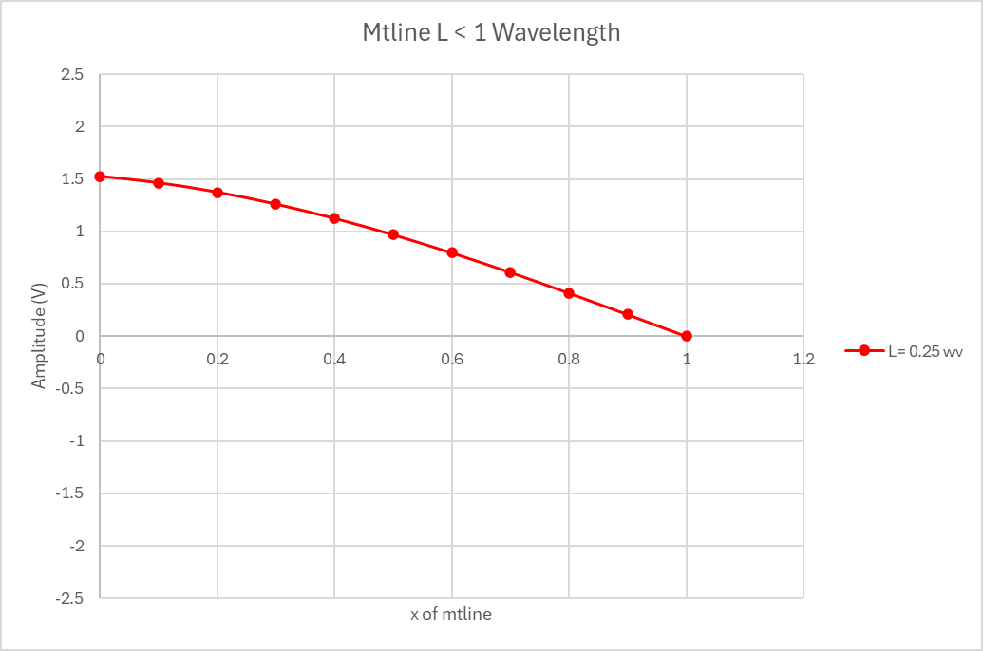

Results
Voltage Amplitudes Vs Distance for L ~ $λ/4$

Slide 10
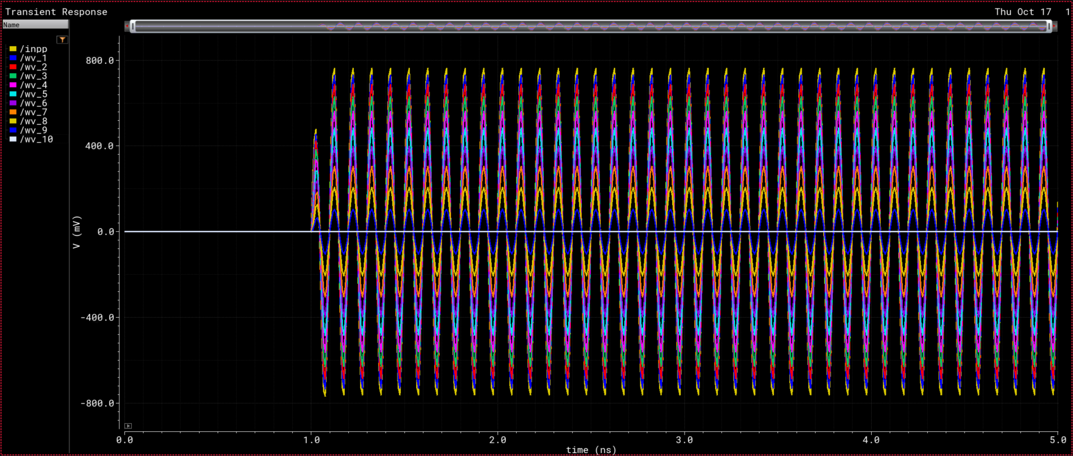

Results
Waveforms for L ~ $λ/4$
Amplitude increased due to reflected wave

Slide 11
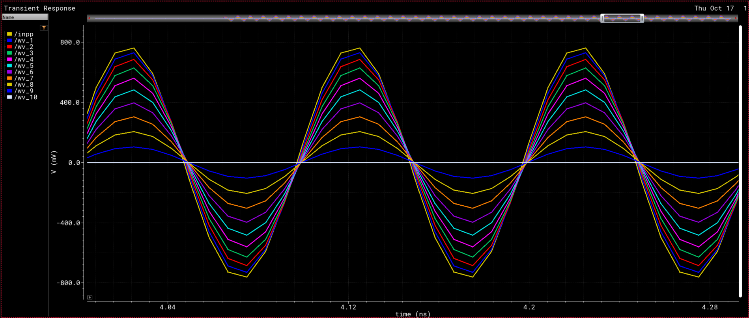
Results
Waveforms for L ~ $λ/4$
inpp (@ Sine Source)
wv_1
wv_2
wv_3
wv_4
wv_5
wv_6
wv_7
wv_8
wv_9
wv_10 (@ Load Side)

Slide 12
2) Open Load
(for λ/2 Resonator)

Slide 13
TB Schematics
Sine Source (10 GHz)
RL = 100T

Slide 14
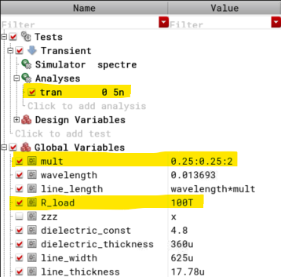
TB Maestro Setup

Slide 15
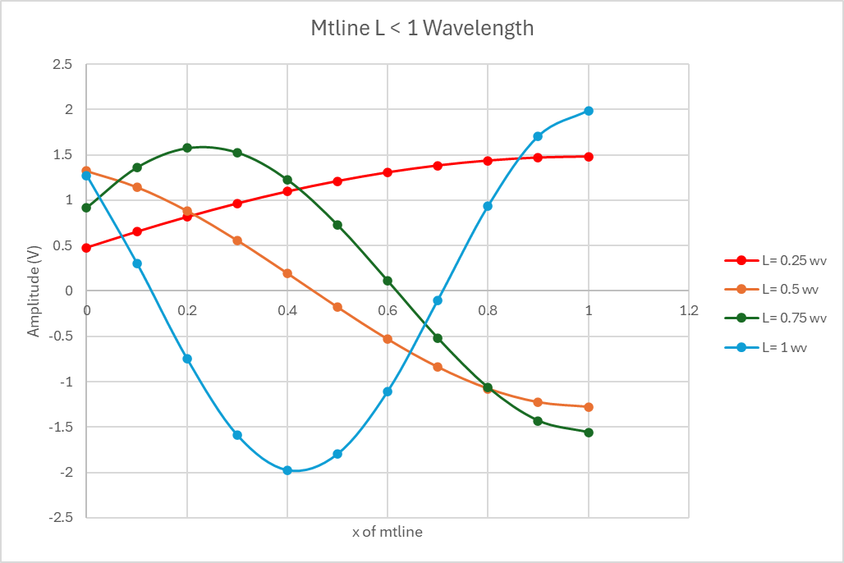
Results
Voltage Amplitudes Vs Distance for different L s

Slide 16
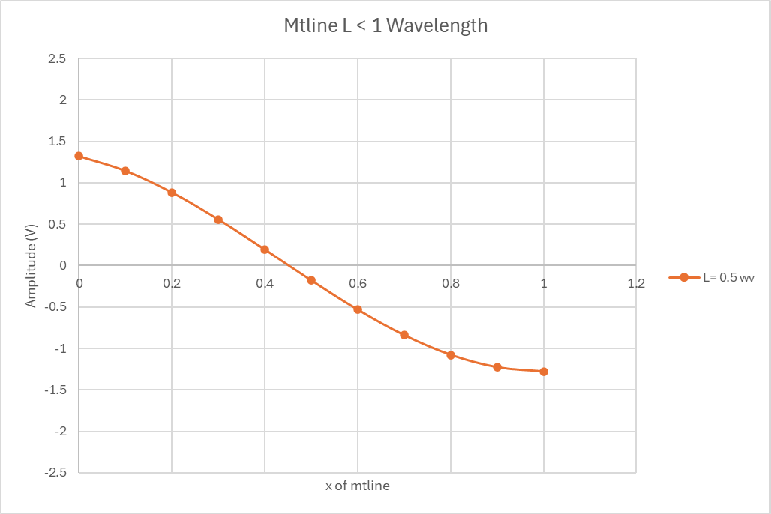

Results
Voltage Amplitudes Vs Distance for L ~ $λ/$2

Slide 17
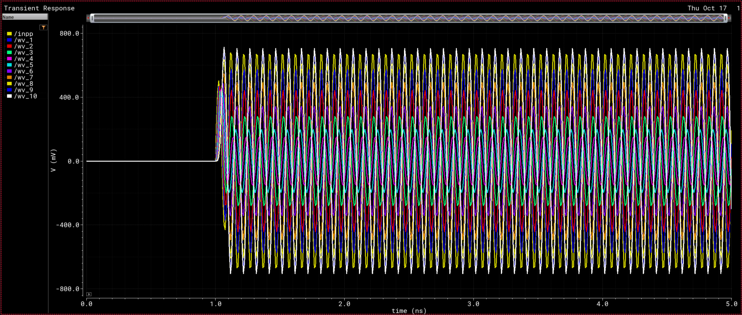

Results
Waveforms for L ~ $λ/$2
Amplitude increased due to reflected wave

Slide 18
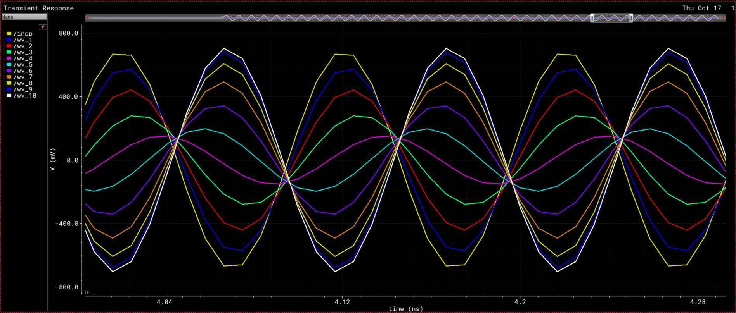

Results
Notice there are some phase-shifts since L is not exactly $λ/$2
Waveforms for L ~ $λ/$2
inpp (@ Sine Source)
wv_1
wv_2
wv_3
wv_4
wv_5
wv_6
wv_7
wv_8
wv_9
wv_10 (@ Load Side)

Slide 19
3) Inductive Load
(for L = λ/4)

Slide 20
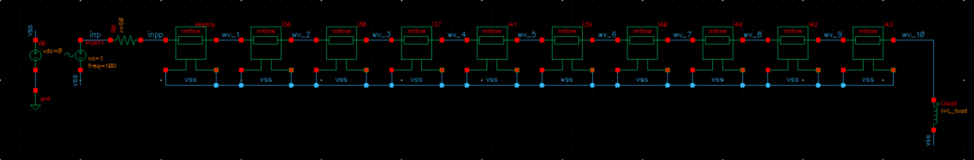
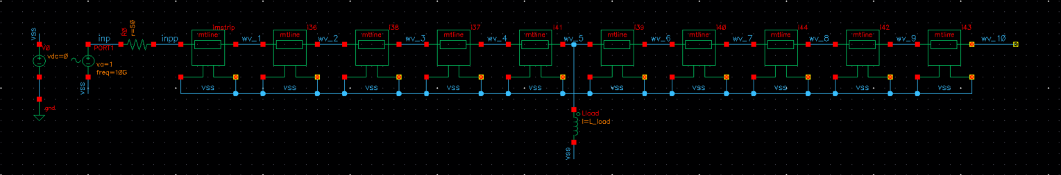
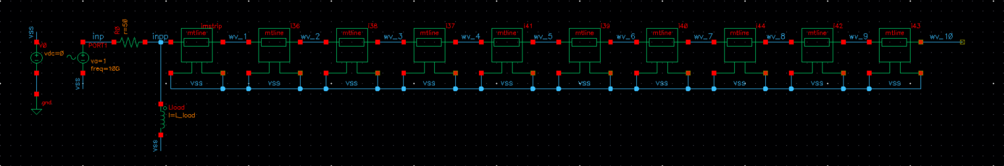
TB Schematics
Far-End
(@ wv_10)
Mid-Point
(@ wv_5)
Near-End
(@ inpp)

Slide 21
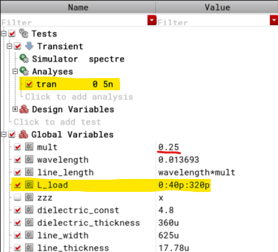
TB Maestro Setup

Slide 22
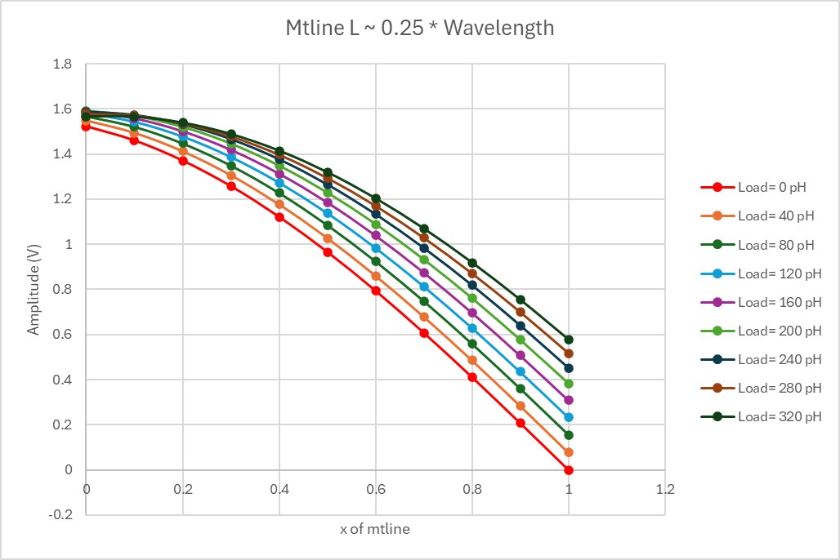
Results
Voltage Amplitudes Vs Distance for different L_load
Inductor connected at the Far-End (@ wv_10)
Short Load
Far-End

Slide 23
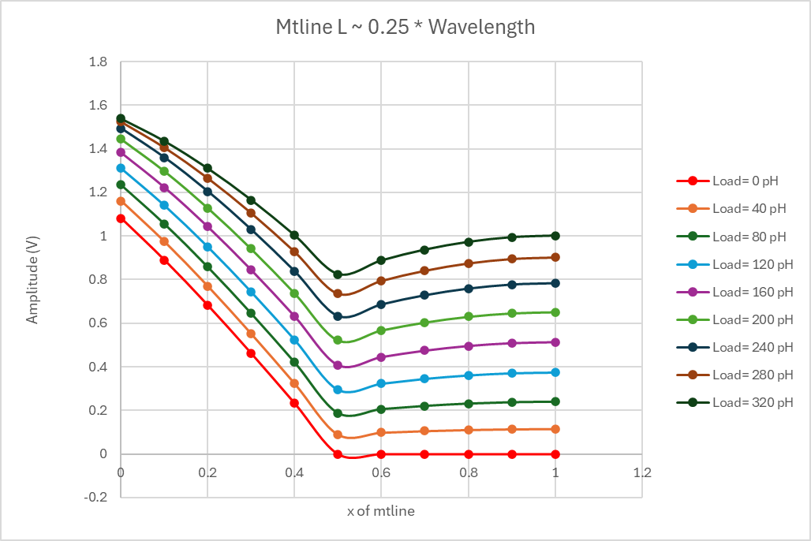
Results
Voltage Amplitudes Vs Distance for different L_load
Inductor connected at Mid-Point (@ wv_5)
Short Load
wv_5

Slide 24
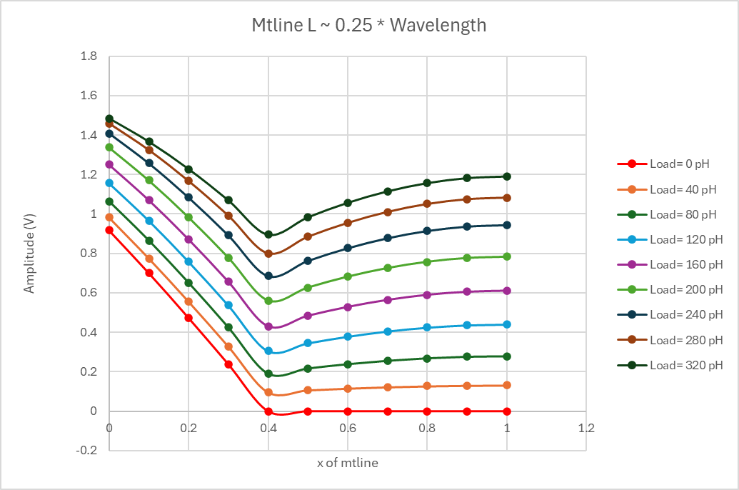
Results
Voltage Amplitudes Vs Distance for different L_load
Inductor connected at Mid-Point (@ wv_4)
Short Load
wv_4

Slide 25
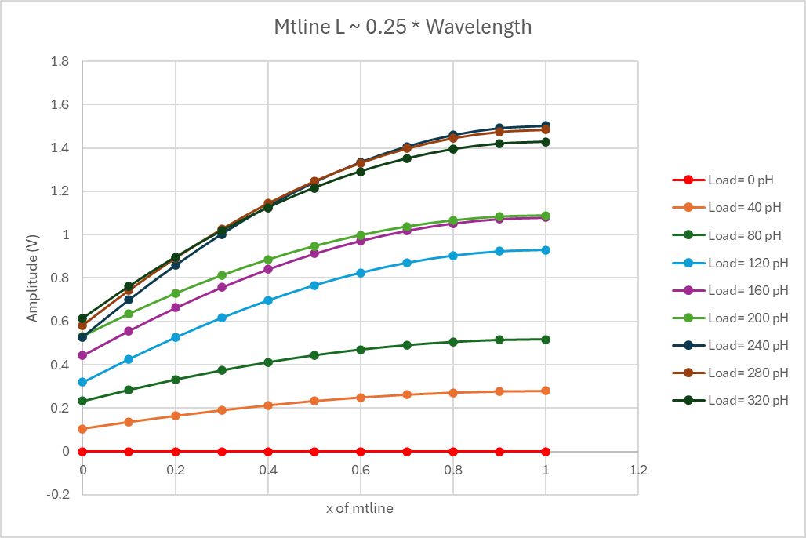
Results
Voltage Amplitudes Vs Distance for different L_load
Inductor connected at the Near-End (@ inpp)
Short Load
Far-End

Slide 26
4) Capacitive Load
(for L = λ/2)

Slide 27

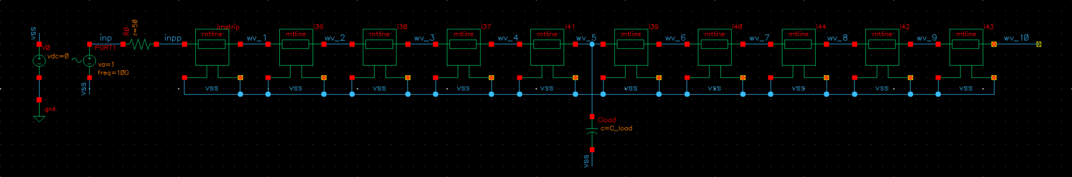
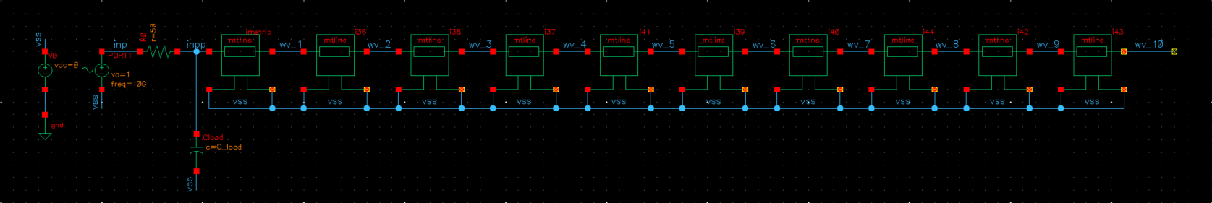
TB Schematics
Far-End
(@ wv_10)
Mid-Point
(@ wv_5)
Near-End
(@ inpp)

Slide 28

TB Maestro Setup

Slide 29
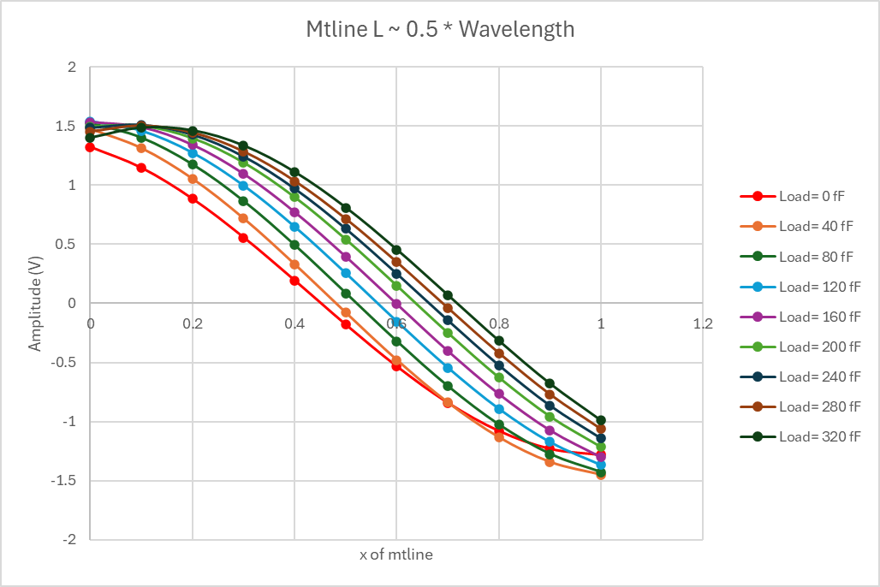
Results
Voltage Amplitudes Vs Distance for different C_load
Capacitor connected at the Far-End (@ wv_10)
Open Load
Far-End

Slide 30
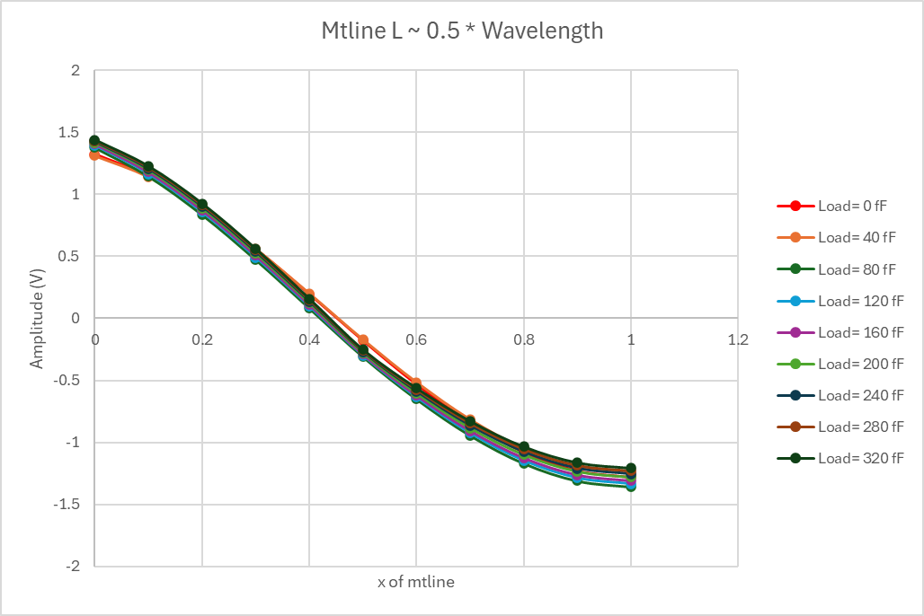
Results
Voltage Amplitudes Vs Distance for different L_load
Capacitor connected at Mid-Point (@ wv_5)
Open Load

Slide 31
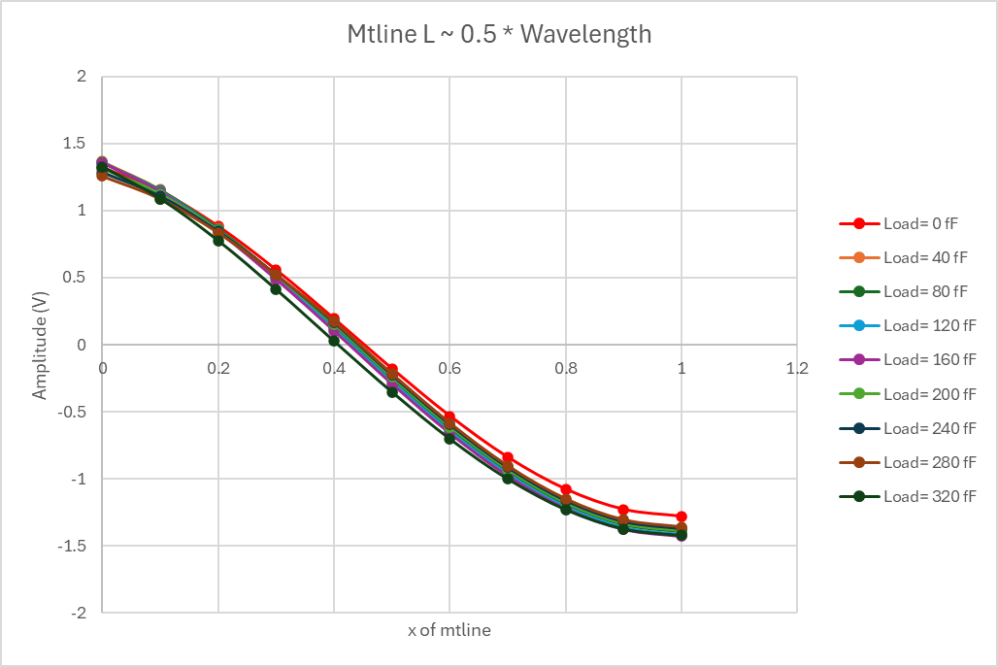
Results
Voltage Amplitudes Vs Distance for different L_load
Capacitor connected at Mid-Point (@ wv_4)
Open Load

Slide 32
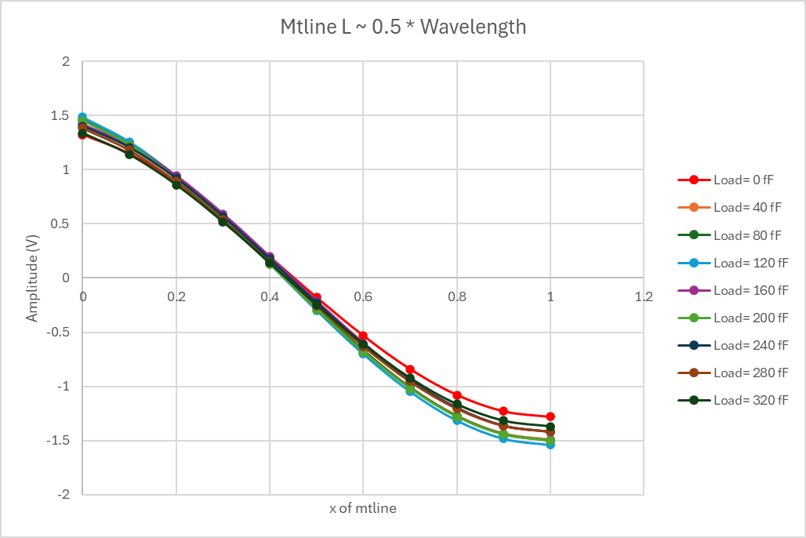
Results
Voltage Amplitudes Vs Distance for different L_load
Capacitor connected at the Near-End (@ inpp)
Open Load

